Slide 1

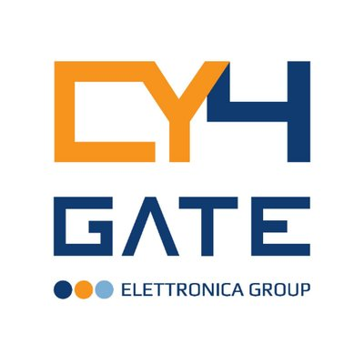
October 21, 2021
Mid Cap Conference - Intermonte

Slide 2
AGENDA
CY4GATE AT A GLANCE
MARKETS & PRODUCTS
1H 2021 RESULTS
STRATEGY & OUTLOOK

Slide 3



CY4GATE at a Glance
CY4GATE a listed company at AIM Italia operating in the 360° cyber market, was founded in 2014 by Elettronica S.p.A (which has been a leader for more than 60 years in the field of Electronic Countermeasures and which is nowadays the majority partner owing about 54% of the shares)
CY4GATE design, develop and produce I-Techs, goods and services which are able to satisfy even the most particular and peculiar “Cyber Intelligence & Cyber Security” needs moved by the Armed forces, Law Enforcement Agencies (LEA’s) and Enterprises within or outside the national borders and markets.
The covered fields and offered services are for example:
QUIPO, Igea, when it comes to Cyber Intelligence; RTA, in the world of Cyber Security.
Strategic and M&A Committee
Domitilla Benigni
Chairman
Emanuele Galtieri
CEO & General Manager
Eugenio Santagata
Member
Alberto Luigi Sangiovanni Vincentelli
Member
Vincenzo Pompa
Independent Member
Enrico Peruzzi
Member
Cinzia Parolini
Independent Member
TOP MANAGEMENT
Domitilla Benigni
CHAIRMAN
Emanuele Galtieri
CEO & General Manager
Marco Latini
CFO & Investor Relations Manager

Slide 4

MARKETS & PRODUCTS

Slide 5

Markets
GLOBAL OPENSOURCE INTELLIGENCE (OSINT) MARKET
GLOBAL LAWFUL INTERCEPTION MARKET
CAGR 2018-2023: +16.8%
CAGR 2018-2023: +24.6%
B€
B€
CYBERSECURITY ANALYTICS, INTELLIGENCE, RESPONSE AND ORCHESTRATION (“AIRO”)
WORLDWIDE
3 fast growing markets
CAGR > 15%
High level of diversification
B€
Source: Global OSINT Market Report, Technavio, IDC
s:

Slide 6


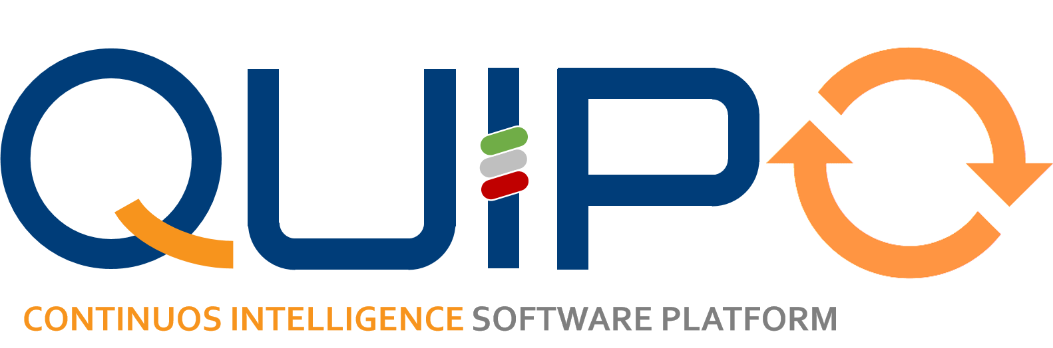

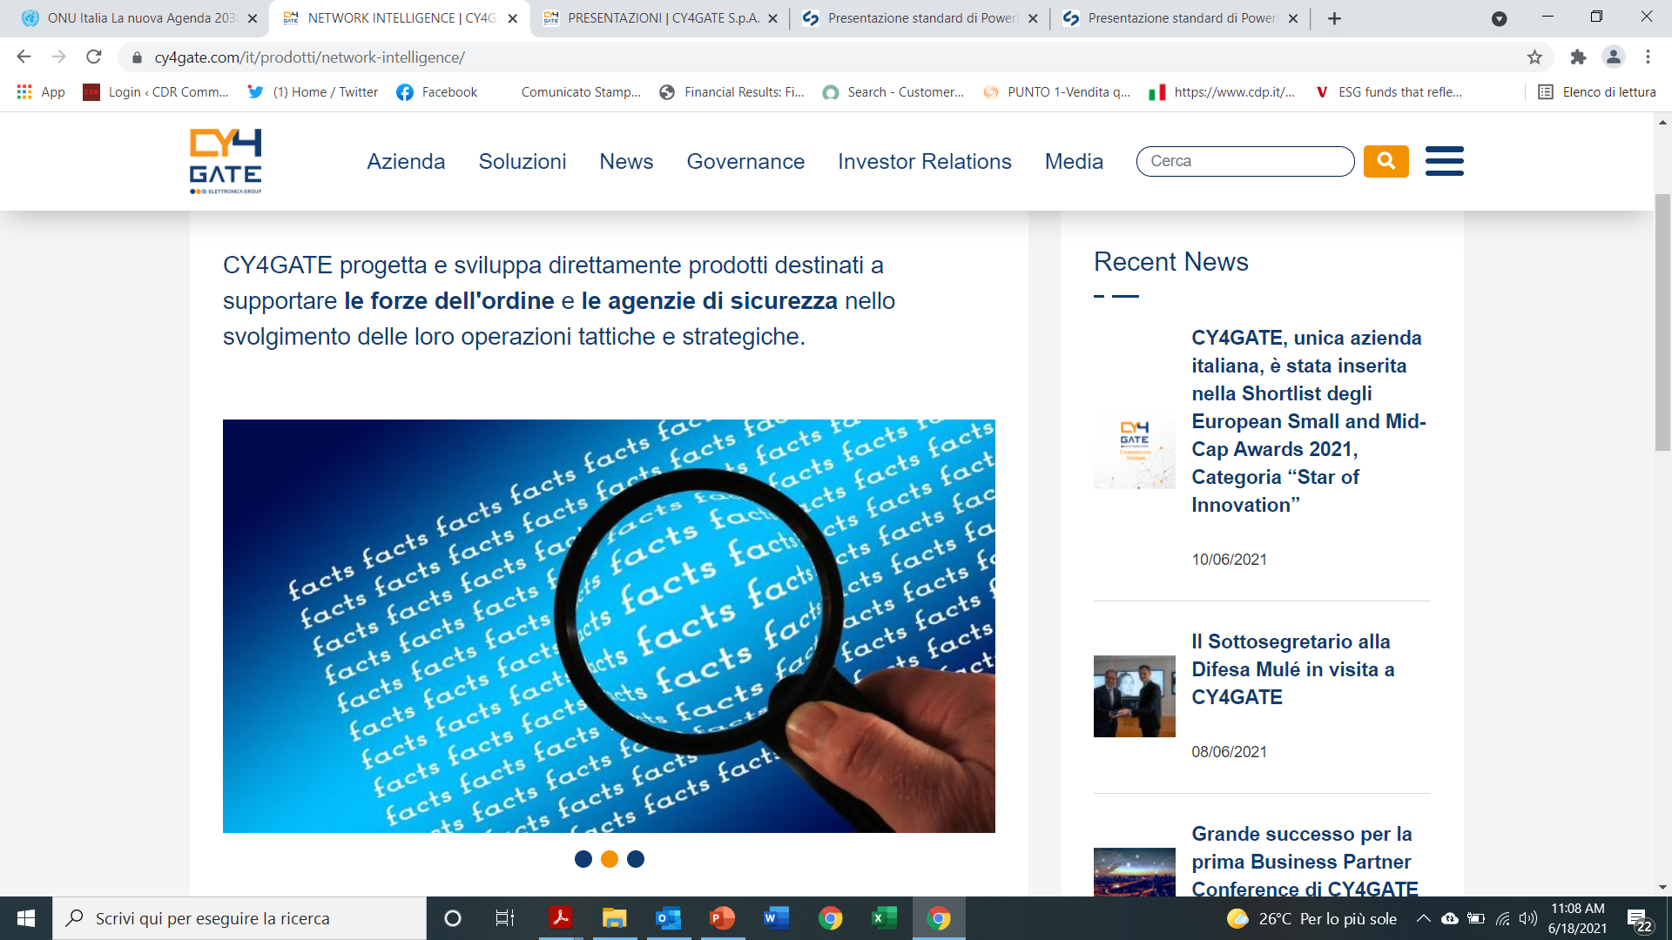
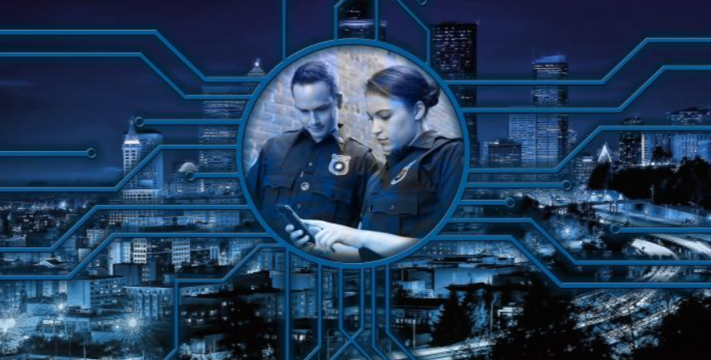
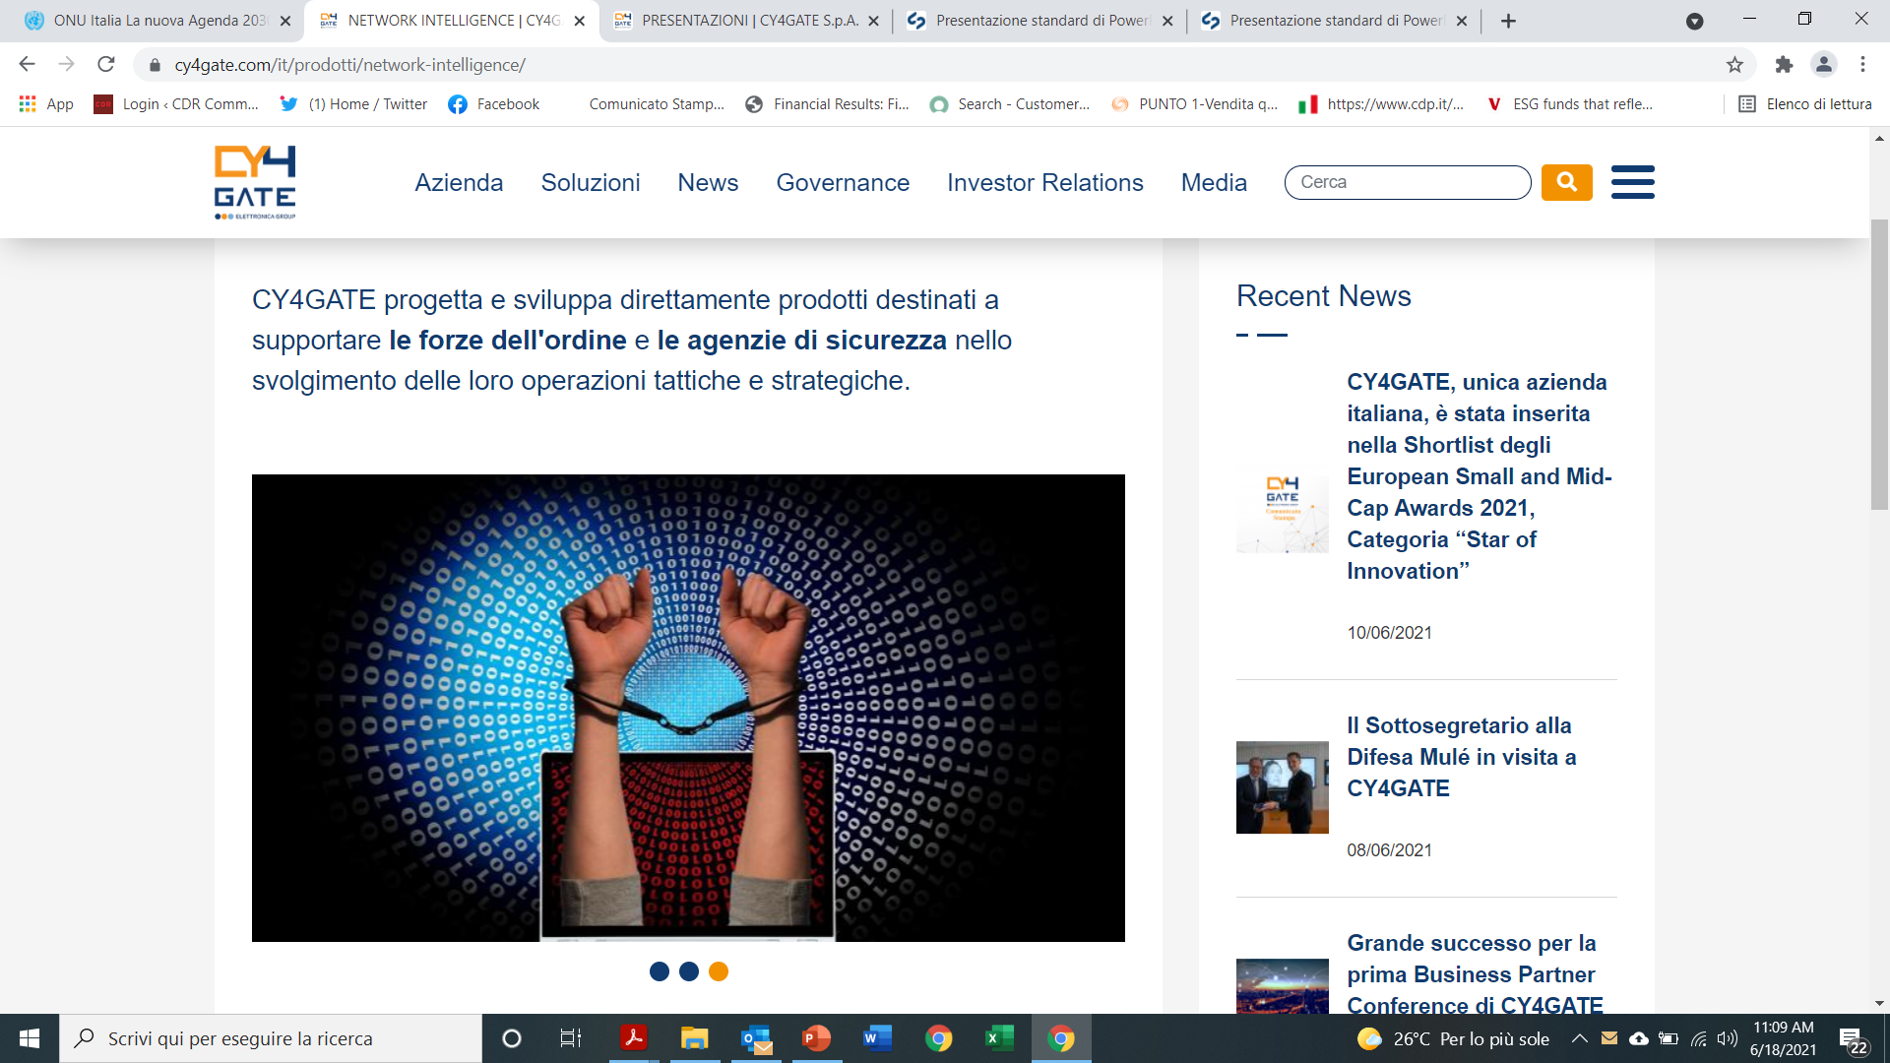
One-Stop-Shop Approach with a Wide Range of Proprietary Products
A unique, defensive and offensive platform of integrated HW and SW proprietary modules to gather, collect, analyze, protect or disrupt data and networks, and to extract and disseminate operational meaningful information
CYBER INTELLIGENCE
CYBER SECURITY
Cyber Intelligence products and services collect and analyze information available online and generated through the use of digital and electronic devices
Cyber security products and services protect clients’ information systems, enabling the detection of anomalies and generating response actions
QUIPO is complete intelligence platform, based on AI technology, able to mix and match: several data sources, for timely and effective reaction to events
SIEM
(Security information and event management)
MONITORING
DECISION INTELLIGENCE PLATFORM
Real time analytics (RTA) is a cyber security application that enables the analyst to detect cyber security anomalies and creates conditions to rapidly strike back. Core product in advanced security operation center (SOC) and security information and event management (SIEM)
CONTINOUS INTELLIGENCE
The Right Information, At The Right Time,
To The Right People, In The Right Way
LAWFUL INTERCEPTION
SOCMINT
(Social Media Intelligence)
Pen test
VA
DGILAB
Academy
Pool of training and educational services covering the following topics:
PT/VA
Cryptoanalysis
Reverse engineering
Malware analysis
Ethical hacker training and education
Cyber resilience military systems
Support law enforcement and int. agencies providing customizable and easy-to-use lawful interception solution

Slide 7
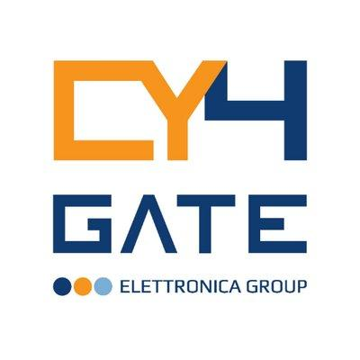

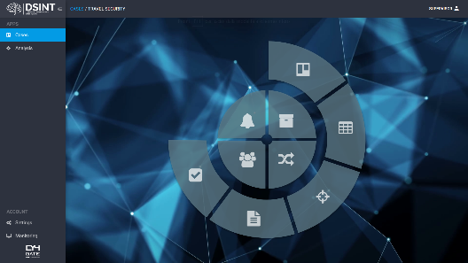
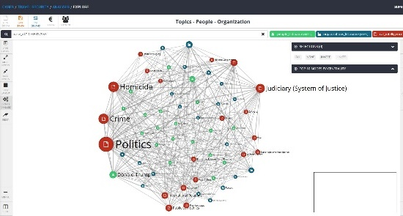
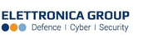
QUIPO
DECISION INTELLIGENCE
The Right Information, At The Right Time,
To The Right People, In The Right Way
QUIPO is a Decision Intelligence platform based on AI algorithms that transforms data into knowledge and provides Decision Support and Decision Augmentation more and beyond traditional solutions based on conventional IT technologies
Value drivers
Multilayer analysis in a unique solution
The integrated collection of multiple information assets (internal or external) enables the possibility to combine multiple analysis models (video tagging, audio tagging, semantic analysis, face recognition, location identification, feature detection, link analysis, etc.).
Prompt Information from large datasets
More effective real time access to external and internal information minimizes reputational risks, and a fraud and product development mitigates costs
Unique platform for Better Intelligence
A central platform, specifically designed to support the intelligence cycle, help the possibility to improve the analysis, dissemination and production possibilities
How Is It Different?
Fully customizable software platform specifically designed for the efficient management of structured and unstructured data
AI Technologies to automate and augment the analysis activities. Different modules (semantic module, image tagging/face recognition modules, “anomalous behaviour” module) which works on machine learning, cognitive computing and deep learning
Multiyear experience in the intelligence domain and enterprises security transformed into a platform that supports analysts from A to Z
7

Slide 8



QUIPO Data Centric Intelligence Architecture
Open Web Sources
Actionable Intelligence
Social Media
AI Algorithms
Automatic Alerting
Multimedia Sources
Threat Reports
Semantic Analysis
Multimedia Analysis
Link Analysis
Trend Analysis
What-If Analysis
Explanable Recommendations
Internal Databases
Dark/Deep Web
AMICO Dissemination
Threat Actor Feeds
Heterogeneus
Data Collection
Data Analysis
Outcome Dissemination

Slide 9

QUIPO Automation for Decision Augmentation
Planning
Data Gathering
Dissemination
Analysis / Enrichment
Production

Slide 10

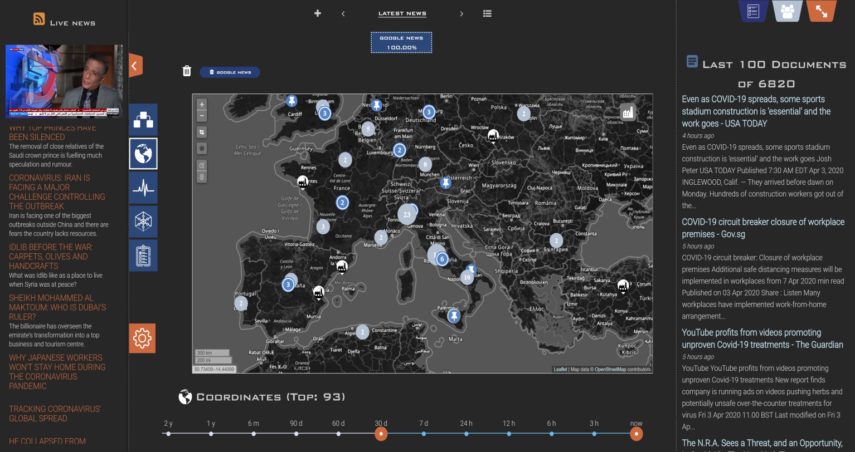
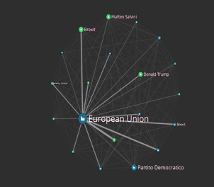
AMICO ‘Advanced Multimedia Information COckpit’
Live News Section
Documents published from QUIPO
360° Actionable Situation Awareness

Slide 11



One-Stop-Shop Approach with a Wide Range of Proprietary Products
A unique, defensive and offensive platform of integrated HW and SW proprietary modules to gather, collect, analyze, protect or disrupt data and networks, and to extract and disseminate operational meaningful information
CYBER INTELLIGENCE
CYBER SECURITY
Cyber Intelligence products and services collect and analyze information available online and generated through the use of digital and electronic devices
Cyber security products and services protect clients’ information systems, enabling the detection of anomalies and generating response actions
QUIPO is complete intelligence platform, based on AI technology, able to mix and match: several data sources, for timely and effective reaction to events
SIEM
(Security information and event management)
MONITORING
DECISION INTELLIGENCE PLATFORM
Real time analytics (RTA) is a cyber security application that enables the analyst to detect cyber security anomalies and creates conditions to rapidly strike back. Core product in advanced security operation center (SOC) and security information and event management (SIEM)
CONTINOUS INTELLIGENCE
The Right Information, At The Right Time,
To The Right People, In The Right Way
LAWFUL INTERCEPTION
SOCMINT
(Social Media Intelligence)
Pen test
VA
DGILAB
Academy
Pool of training and educational services covering the following topics:
PT/VA
Cryptoanalysis
Reverse engineering
Malware analysis
Ethical hacker training and education
Cyber resilience military systems
Support law enforcement and int. agencies providing customizable and easy-to-use lawful interception solution

Slide 12

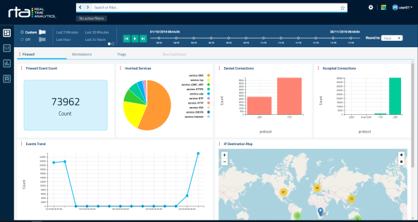
RTA
Upgrade your threat detection tools
Real Time Analytics (RTA) is a cyber security application framework that allows: Ingestion, Processing, Enrichment and analysis of different kind of security events
RTA enables the analyst to detect anomalies and establishes the conditions to rapidly strike back
Value drivers
Sensors are everywhere
Smart collection and normalization of every sensor enables: understandable data meaning, rapid detection of any anomaly among billions of data. Also raw Network traffic can be collected and analysed as for events
More Enrichment → More Context → Better Insight
RTA enrich all incoming events adding information related to the execution context, the involved entities and the purpose of the action because the more context we have the more insights we can have
Drill down and Situation Awareness
A single point of view for the Analyst allows for more efficient browsing thus helping to detect entities and their relationships. RTA is able to identify relationship network, through visualization tools allowing for a more accurate analysis of threats
How Is It Different?
RTA can be defined as a “Time Machine” which allows the analyst to gather information history in order to “freeze the crime scene” in dynamic and ever-changing situations. This Time Machine also allows the Analyst to flash forward to gather information regarding potential effects of occurring events
Real Time Analytics collects event information from plenty of sources. It then map and classify the events through various adapters. In this manner, events are enriched and correlated with information from external sources using Artificial Intelligence Technologies for smarter exploitation
Alarms are based on correlation, machine learning or behavioral rules Alarms are operated by the indexing engine and then transferred to the graphical user interface which allows the analyst to perform several actions simultaneously to handle alarms
12

Slide 13













RTA Solution Architecture
EVENTS
Security Devices
LOG&AUDIT
ACQUISITION
ENRICHMENT
ANALYSIS
PRESENTATION & DISSEMINATION
Systems
Event Correlation
Machine Learning
User&Entity Behavior Analytics
NETWORK TRAFFIC
Network Devices
LOG&AUDIT
Cloud
Enrichment
Sources
Threat Intelligence Sources

Slide 14
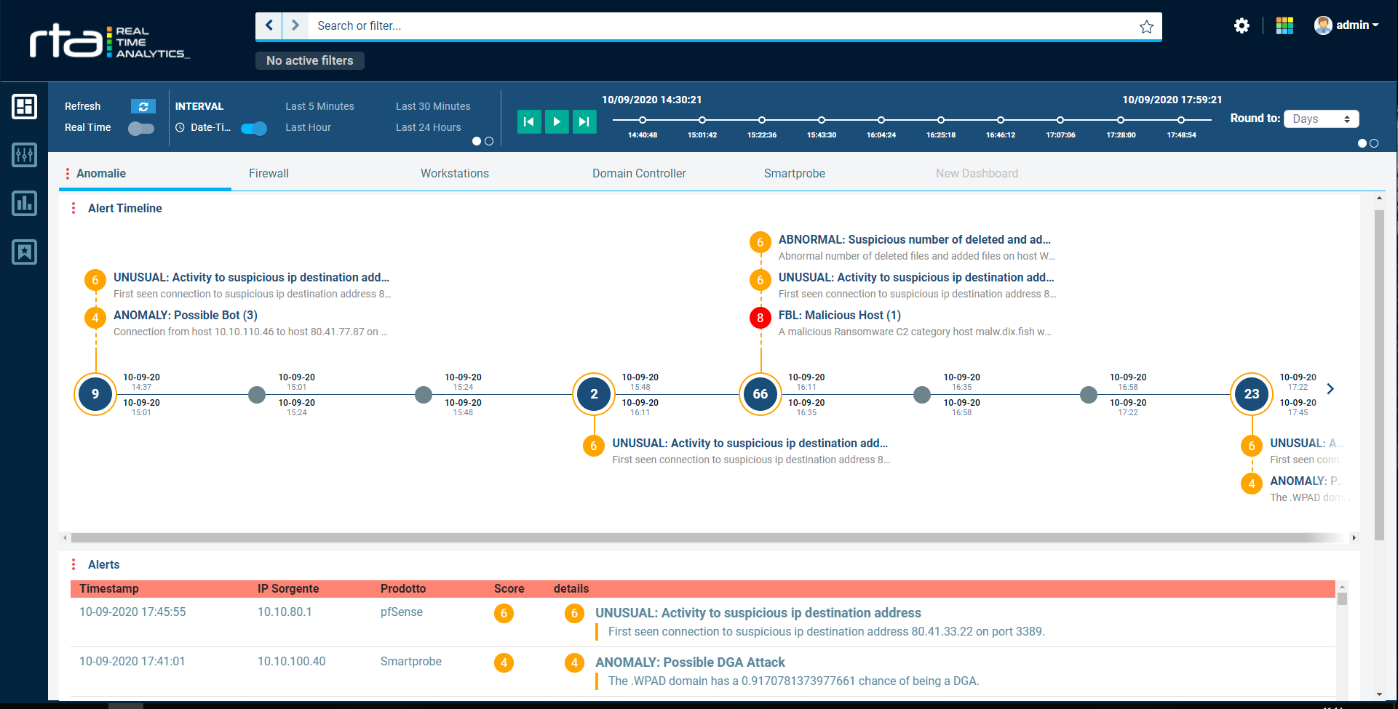
RTA: Augmented Incident Management Process

Slide 15
One-Stop-Shop Approach with a Wide Range of Proprietary Products
A unique, defensive and offensive platform of integrated HW and SW proprietary modules to gather, collect, analyze, protect or disrupt data and networks, and to extract and disseminate operational meaningful information
CYBER INTELLIGENCE
CYBER SECURITY
Cyber Intelligence products and services collect and analyze information available online and generated through the use of digital and electronic devices
Cyber security products and services protect clients’ information systems, enabling the detection of anomalies and generating response actions
QUIPO is complete intelligence platform, based on AI technology, able to mix and match: several data sources, for timely and effective reaction to events
SIEM
(Security information and event management)
MONITORING
DECISION INTELLIGENCE PLATFORM
Real time analytics (RTA) is a cyber security application that enables the analyst to detect cyber security anomalies and creates conditions to rapidly strike back. Core product in advanced security operation center (SOC) and security information and event management (SIEM)
CONTINOUS INTELLIGENCE
The Right Information, At The Right Time,
To The Right People, In The Right Way
LAWFUL INTERCEPTION
SOCMINT
(Social Media Intelligence)
Pen test
VA
DGILAB
Academy
Pool of training and educational services covering the following topics:
PT/VA
Cryptoanalysis
Reverse engineering
Malware analysis
Ethical hacker training and education
Cyber resilience military systems
Support law enforcement and int. agencies providing customizable and easy-to-use lawful interception solution

Slide 16

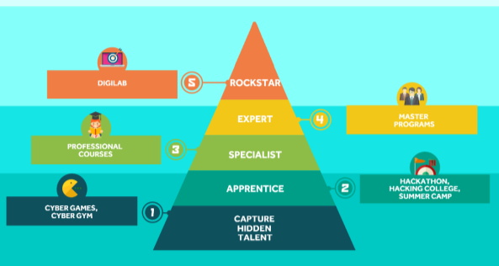
CY4GATE
ACADEMY
Advanced knowledge, skills, capability
CY4Gate Academy provides recruiting, educational and training programs to address today’s needs in intelligence, cyber intelligence and cyberwarfare.
Value drivers
Capability Oriented
Capability refers to the process of converting 'cyber knowledge' into specific results. ”Cyber Knowledge”, indeed, never transforms in cyber capability automatically because requires a combined hands-on and exercise oriented approach
Creating better staff
Your staff deserves the opportunity to learn, begin and grow a career in the cyber and intelligence fields
More Readiness → Better Security
Becoming prepared about threats and the best techniques to face them, will make it harder for a cybercriminal to access your data
How Is It Different?
Some (successful) cybersecurity expert skills simply cannot be taught in a traditional classroom. This is why we always offer Modern vocational training and skills education programs through interactive scenarios, “cyber arenas” where to simulate real cyber competition, and challenges to solve real-world business and human competitions
“Learning elements, contents, and skills” together. Bringing together all the best cyber security and cyber intelligence elements, from those who are doing it, those who did it, and those who learned from it, and delivering to your organization
CY4GATE Academy offers an innovative method for assessment inside and outside your organization
16

Slide 17

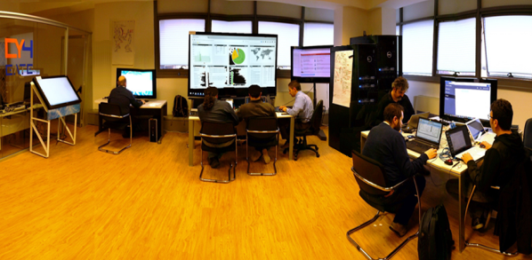
DIGILAB
Prepare Your Cyber Mission!
The DIGILAB is a strategic asset, dedicated to perform digital activities for platform and system analysis, vulnerability management, attack pattern engineering
Value drivers
Beyond the Academic Approach
The building up of a lasting capability on all the aspects of Cyber Warfare can hardly be achieved by traditional education & training which is useful for the creation of individual competences, but not sufficient to establish a permanent capability. So, also for this reason we have DIGILAB that integrates our Cyber Academy offering
Tailored around the Customer
Every customer has his needs and for this reason each DIGILAB is a unique mix of education, training, labs and continuous support for preparing customer’s missions
Focused on Teamworking
Final goal of a DIGILAB program is to train all the teams (Penetration Testing team, Intelligence Team , Malware reversing and exploiting team, Reversing team, Crypto-analysis team and so on) to understand how to approach a cyber mission and identify the right tools for each specific task
How Is It Different?
We own full penetration testing and validation capabilities against complex systems to check the HW, SW, firmware. Also the wireless level
We create laboratories and services for malicious code analysis and define a valid counter-strategy
We can reverse engineer things to catch how a device or algorithm works
17

Slide 18

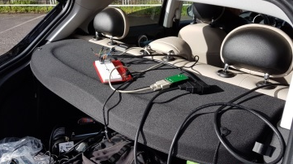
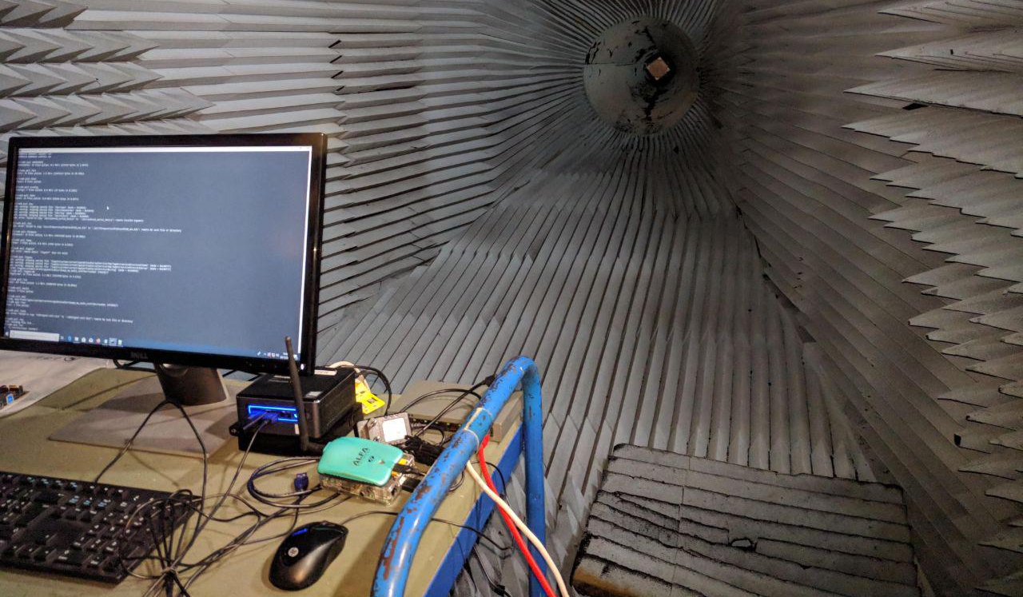
CYBER SECURITY
SERVICES
First things first: protect yourself, always
Thanks to our specialists’ experience and expertise, we have developed a package of Cyber Security Services to increase your organization’s information security and minimize the impact in the event of a data breach.
Value drivers
One cyber attack can destroy All
It's not a matter of IF, it's a matter of WHEN. The cost can be catastrophic and more expensive compared to the cost of implementing a proper cyber security strategy
Effective Cyber Security increase trust and productivity
A computer incident decrease trust on data and services and affects your productivity. At the same time if you can demonstrate your resilience to cyber threats, you can inspire trust in your stakeholders
Know the impact of Kill-chains
Decision-makers need to have visibility regarding the real exposure of the critical processes to cyber attacks. We can use advanced penetration testing capabilities to validate the underlying technologies and simulate the impact of a complex cyber attack
How Is It Different?
Working shoulder-to-shoulder with you, we fully support our customers through cyber defense strategy and governance
Cyber security isn’t a single problem, with one solution. It‘s a continuous battle. We offer a wide range of cyber security services focused on our customers’ need to grant them long-term value for your business
Our cyber experts protect many organizations with proven services and solutions for the full cyber security lifecycle
We can assess all layers of a target technology, looking inside the software, hardware, firmware and wireless level and combining dynamic and static analysis with reverse engineering capabilities
18

Slide 19
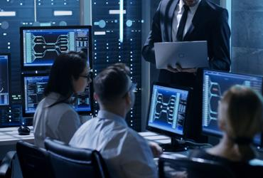
1H 2021 RESULTS

Slide 20
1H 2021 Financial Highlights
Keep on proprietary SW products commercialization, enabling revenues growth and solid margin and cash generation
REVENUES
R&D INVESTMENTS
YoY %
+25.1%
YoY %
+59.0%
EBITDA
NET PROFIT
Margin (%)
47.2%
34.7%

Slide 21
Revenues Breakdown 1H 2021
By clients: improved penetration in the corporate market
By Type: focused on products commercialization
By Geographical area: increased foreign sales thanks to business development initiatives

Slide 22
Investments
Significant investment in staff: +31 FTE YoY
+22 direct staff: reinforced to meet the needs of R&D projects and upcoming contractual deliveries.
50% of incremental staff cost, around €700/k, invested in R&D activities
+9 resources mainly related to strengthening the sales force to support the company's strategic market presence
.

Slide 23
BP 2021 - 2023
TARGETS 2023
REVENUES
€M
CAGR 2020-2023: +40%
EBITDA Margin
> 40 %
Net Financial Position
POSITIVE

Slide 24

STRATEGY & OUTLOOK

Slide 25


High Potential Momentum for Value Creation
Significant commercial opportunities on the foreign market and on the Italian government
Attractive and growing markets: Cyber Intelligence and Cyber Security
360° cyberhouse: unique in the Italian competitive landscape
Robust technology engine: 5 proprietary solutions and CEWIS
Positioning on key technological trends identified by Gartner in the corporate reference sectors (advanced decision intelligence and SIEM systems)
PNRR
Cyber Security
National and European regulatory framework suitable to the growth of European digital SW companies
Opportunities
SIEM/DSS
Funds linked to the PNRR "National Recovery and Resilience Plan" on digital innovations and cybersecurity

Slide 26
Strategic Plan fueled by both Organic and External Growth
Strategy pillars
Commercial/ Sales
Salesforce development to improve Italian market penetration coupled with reinforced commercial efforts to strengthen agreements with key partners
Products
Development
Creation of integrated solutions through the development of new functions with the aim of creating a competitive product offering both in Italy and abroad
Brand
Positioning
Improvement of brand positioning and visibility through proper communication campaign and opening of commercial branches
M&A Activity, Talent Acquisition and Retention
Cy4Gate aims to expand its business through M&A activity and to gather the best human resources operating in the reference industry

Slide 27




M&A Target: RCS LAB
RCS LAB is the main Italian supplier of interception tools.
It is headquartered in Milan, Italy, and its customers include public prosecutors, law enforcement agencies, and secret services, to whom it supplies software for environmental, telephone and telematic interception, as well as systems for the advanced analysis of investigative information, with revenues of approximately € 40 million
Rationale of operation
Market reach: consolidate Italy and create growth opportunities in Europe
Important synergies in R&D without overlapping but with product integration
Creation of an Italian cyber security and cyber intelligence centre

Slide 28

THANK YOU

Slide 29





CONTACTS
  CFO & IR MANAGER
  Marco Latini
  marco.latini@cy4gate.com
FOLLOW US:
  IR ADVISOR
  CDR Communication
  Silvia Di Rosa silvia.dirosa@cdr-communication.it
  Luca Gentili luca.gentili@cdr-communication.it

Slide 30
DISCLAIMER
THIS PRESENTATION AND ANY OTHER INFORMATION DISCUSSED AT THE PRESENTATION (THE “PRESENTATION”) IS STRICTLY CONFIDENTIAL AND IS BEING PROVIDED TO YOU SOLELY FOR YOUR INFORMATION. THIS PRESENTATION, WHICH HAS BEEN PREPARED BY CY4GATE S.p.A. (THE “COMPANY”), IS PRELIMINARY IN NATURE AND IS SUBJECT TO UPDATING, REVISION AND AMENDMENT. THIS PRESENTATION MAY NOT BE REPRODUCED IN ANY FORM, FURTHER DISTRIBUTED OR PASSED ON, DIRECTLY OR INDIRECTLY, TO ANY OTHER PERSON, OR PUBLISHED, IN WHOLE OR IN PART, FOR ANY PURPOSE. ANY FAILURE TO COMPLY WITH THESE RESTRICTIONS MAY CONSTITUTE A VIOLATION OF APPLICABLE LAWS AND VIOLATE THE COMPANY’S RIGHTS.
This Presentation is being made available to a limited number of recipients solely for the purpose of introducing the Company. This Presentation does not, and is not intended to, constitute or form part of, and should not be construed as, an offer to sell, or a solicitation of an offer to purchase, subscribe for or otherwise acquire, any securities of the Company, nor shall it or any part of it form the basis of or be relied upon in connection with or act as any inducement or recommendation to enter into any contract or commitment or investment decision whatsoever. Neither this Presentation nor any copy of it nor the information contained herein is being issued or may be distributed or redistributed directly or indirectly to or into any jurisdiction where such distribution would be unlawful, including but not limited to, the United States, Canada, Australia and Japan. None of the Company or any of its partners, directors, officers, employees, agents, other representatives, consultants, legal counsel, accountants, financial or other advisors, auditors, direct or indirect shareholders, subsidiaries or other affiliates or any other person acting on behalf of any of the foregoing (collectively, the “Representatives”) makes any representation or warranty, expressed or implied, as to the fairness, quality, accuracy, relevance, completeness or sufficiency for any purpose whatsoever of any information contained in this Presentation. By attending or otherwise accessing this Presentation, you acknowledge and agree not to be entitled to rely on the fairness, quality, accuracy, relevance, completeness or sufficiency for any purpose whatsoever of the information contained herein and that none of the Company or any of its Representatives will have any liability relating to, or resulting from, this Presentation, its inaccuracy or incompleteness, or the use of, or reliance upon, this Presentation. By attending or otherwise accessing the Presentation, you acknowledge and agree that you will be solely responsible for your own independent evaluation and assessment of the Company and of the information contained in this Presentation and will rely solely on your own judgment and that of your qualified advisors in evaluating the Company and in determining the desirability of the possible acquisition of an interest in the Company.
To the extent applicable, the industry and market data contained in this Presentation has come from official or third-party sources. Third-party industry publications, studies and surveys generally state that the data contained therein have been obtained from sources believed to be reliable, but that there is no guarantee of the fairness, quality, accuracy, relevance, completeness or sufficiency of such data. The Company has not independently verified the data contained therein. In addition, certain of the industry and market data contained in this Presentation come from the Company’s own internal research and estimates based on the knowledge and experience of the Company’s management in the market in which the Company operates. Such research and estimates, and their underlying methodology and assumptions, have not been verified by any independent source for accuracy or completeness and are subject to change without notice. Accordingly, undue reliance should not be placed on any of the industry or market data contained in this Presentation.
The highlights of the Company and the outlook presented in this Presentation represent the subjective views of the management of the Company and are based on significant assumptions and subjective judgments which may or may not prove to be correct. Industry experts, business analysts or other persons may disagree with these views, assumptions and judgments, including without limitation the management’s view of the market and the prospects for the Company.
This Presentation may include statements that are, or may be deemed to be, forward-looking statements. Forward-looking statements typically use terms such as “believes”, “projects”, “anticipates”, “expects”, “intends”, “plans”, “may”, “will”, “would”, “could” or “should” or similar terminology. Any forward-looking statements in this Presentation are based on the Company’s current expectations and, by their nature, forward-looking statements are subject to a number of risks and uncertainties, many of which are beyond the Company’s control, that could cause the Company’s actual results and performance to differ materially from any expected future results or performance expressed or implied by any forward-looking statements. The Company undertakes no obligation to release the results of any revisions to any forward-looking statements in this Presentation that may occur due to any change in its expectations or to reflect events or circumstances after the date of this Presentation and the Company and its Representatives disclaim any such obligation.
Except where otherwise indicated, this Presentation speaks as of the date hereof and the information and opinions contained in this Presentation are subject to change without notice and do not purport to contain all information that may be required to evaluate the Company. The information in this Presentation is in preliminary form and has not been independently verified. The Company and its Representatives undertake no obligation to provide the recipients with access to any additional information or to update or revise this Presentation or to correct any inaccuracies or omissions contained herein that may become apparent. To the fullest extent permissible by law, such persons disclaim all and any responsibility or liability, whether arising in tort, contract or otherwise, which they might otherwise have in respect of this Presentation. Recipients should not construe the contents of this Presentation as legal, tax, regulatory, financial or accounting advice and are urged to consult with their own advisers in relation to such matters.
These materials are not an offer for sale of securities in the United States. The Company does not intend to register under the US Securities Act of 1933, as amended (the “Securities Act”), or with any securities regulatory authority of any state or other jurisdiction of the United States, and securities of the Company may not be offered, sold, resold, pledged, delivered, distributed or transferred, directly or indirectly, into or within the United States except pursuant to an exemption from, or in a transaction not subject to, the registration requirements of the Securities Act and in compliance with any applicable securities laws of any state or other jurisdiction of the United States. The Company does not intend to make any public offering of its securities in the United States. Any securities will be sold only (i) in the United States, to qualified institutional buyers (as defined in Rule 144A under the Securities Act) pursuant to Rule 144A and (ii) to non-U.S. persons outside the United States in reliance on Regulation S under the Securities Act.
By attending or otherwise accessing this Presentation, you warrant, represent, undertake and acknowledge to the Company that (a) you have read and agree to comply with the foregoing limitations and restrictions including, without limitation, the obligation to keep this Presentation and its contents confidential, (b) you agree to treat this Presentation and its content as strictly private and confidential and to take all necessary steps to preserve such confidentiality, (c) you are able to receive this Presentation without contravention of any applicable legal or regulatory restrictions. By attending or otherwise accessing this Presentation, you agree to be bound by the foregoing limitations. Any failure to comply with these restrictions may constitute a violation of the laws of any such other jurisdiction. Any potential investment or investment activity to which this Presentation relates is available only to persons eligible to invest in securities and will be engaged in only with such persons.

